Slide 1

Web Development 1
© Hugh McCabe & Matt Smith 2008-2014
Lecture 2c
CSS - Cascading Style Sheets - introduction

Slide 2
Introduction
Have already seen example of style sheets in action.
Now time to delve into them in detail.
Start with terminology and fundamental concepts.
Then look at powerful CSS methods for formatting text.
www.csszengarden.com
Great examples of what you can do with CSS ….

Slide 3
How Style Sheets Work
It’s as easy as 1-2-3-test
Start with a document marked up in HTML
Write style rules for how you want the different elements to look
Attach the style rules to the document
(then TEST – validate and with humans) …
You already know how to correctly mark-up a document with HTML
So let’s move on to writing the CSS style rules

Slide 4
Writing The Rules

Slide 5
Writing The Rules
A style sheet is made up of one or more style rules
Describe how element or group of elements should be displayed
Each rule selects one or more elements and declares how it should look
Following example contains two rules.
The first one makes text of all h1 elements green.
The second specifies that paragraphs should be in small, sans-serif font
h1 { color: green; }
p { font-size: small; font-family: sans-serif; }

Slide 6
Writing The Rules
In CSS terminology a rule consists of:
Selector: identifies the element(s) affected
Declaration: provides the display instructions
Declared inside braces (curly brackets) { … }
Can have several declarations, each ending with a semi-colon ;
In previous examples selectors were h1 and p.
Each declaration made up of property (such as color) and value (such as green).
Property separated by a colon from value
The value followed by semi-colon

Slide 7
Writing The Rules
General form of CSS rule:
selector {
property: value;
}
Can be multiple declarations within each rule e.g.
selector {
property1: value1;
property2: value2;
property3: value3;
}

Slide 8
Writing The Rules: Element selectors
Selectors
In previous examples h1 and p element names are used as selectors
Most basic type of selector is called an element type selector
Declarations will apply to every h1 and p element in document
Other methods of more finely controlling which elements will have rules applied to them
Learn more about those another day …

Slide 9
Writing The Rules
Declarations
Declaration is property/value pair.
Can be more than one declaration in each rule
Each declaration must end with a semi-colon
List of declarations associated with rule placed in curly brackets
sometimes known as declaration block
Easier to read if each declaration on separate line e.g.
p {
font-size: small;
font-family: sans-serif;
}

Slide 10
Writing The Rules
Each HTML element has set list of associated properties
Values that these properties can take are dependent on the property
Some properties:
take length measurements,
some take colour values,
others have a predefined list of keywords
E.g.
can’t supply value in inches to a color property,
can’t supply color keyword ‘green’ to a width property
etc.

Slide 11
Attaching style rules to the document

Slide 12
Attaching The Rules
There are three different ways in which the style rules can then be attached to the document.
External Style Sheets
2. Embedded Style Sheets
3. Inline Styles

Slide 13
Attaching The Rules
There are three different ways in which the style rules can then be attached to the document.
External Style Sheets
2. Embedded Style Sheets
3. Inline Styles
Nice and simple:
ALWAYS use external style sheets
I.e. style rules defined in a separate text file from the HTML content – as you’ve been doing so far
ALWAYS – ALWAYS – ALWAYS
☑☺
☹☒

Slide 14
1. External Style Sheets
Don’t forget the semi-colon
This is the method for professional sites
i.e. for ALL of your work
Separate text document containing style rules
Named with suffix ".css"
Can be imported into (or linked to), any HTML document we want. E.g.:
<head>
<meta charset="utf-8">
<title>Document title here</title>
<style>
@import "css/mystyles.css”;
</style>
</head>

Slide 15
Alterntative is: link
If writing high volume access / high performance website, you may prefer to use <link>
<head>
<meta charset="utf-8">
<title>Document title here</title>
<link rel="stylesheet" type="text/css" href="css/mystyles.css“>
</head>
But let’s keep it simple for now and stick to @import

Slide 16
VALIDATION of CSS

Slide 17
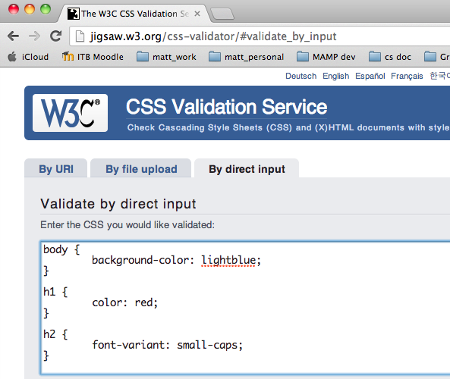

Slide 18
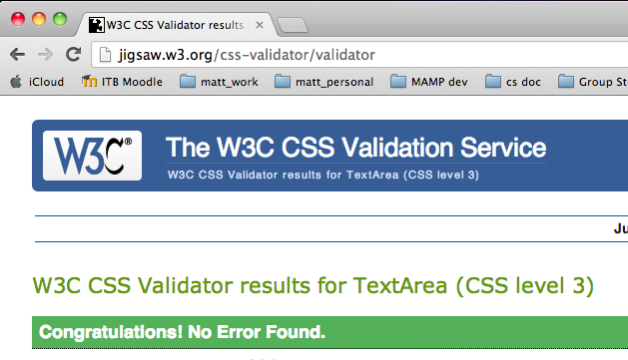

Slide 19
Comments in Style Sheets

Slide 20
Comments /* I am a comment */
The common computer language multi-line comment can be used in CSS style sheets
Slash-star comment text star-slash
/* I am a comment */
The content of comments ignored by browser
As usual, 2 common uses for comments
(1) notes / text for humans to read
(2) a way to ‘disable’ style rules or parts of style rules

Slide 21
Comments – for humans - example
/* -----nav styles------ */
nav {
width: 40%;
background-color: yellow;
}

Slide 22
Comments – disable code - example
nav {
width: 40%;
/* background-color: yellow; */
}
Background color now “commented-out”
So this declaration now ignored by browser

Slide 23
2 things to note about CSS comments
Comments are written DIFFERENTLY in HTML and CSS
Put the RIGHT kind of comment in each type of file ☺
/* I am a CSS comment */
<!-- I am an HTML comment -->
The CSS comment is just like a multi-line comment in programming languages like Java, PHP, C# etc.
BUT there is NO SINGLE LINE comment equivalent in CSS
// this is NOT a valid comment in CSS

Slide 24
Big Concepts - Inheritance

Slide 25
Big Concepts - Inheritance
HTML elements inherit styles from elements they are contained in.
Huh?
Consider the following style rule:
p { font-size: small;
font-family: sans-serif;
}
Suppose we apply it to document containing this:
<p>This is an example of <em>inheritance</em>. Inheritance allows economical use of style rules
</p>

Slide 26
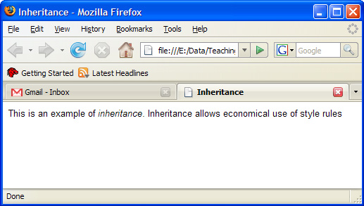
Big Concepts - Inheritance
Here’s the result.
Notice the word “inheritance”
italicised, but also displayed small and in sans-serif font

Slide 27
Big Concepts - Inheritance
No style rules specifed for em elements
so why did browser do this?
Browser styled em element because it is located inside the p element,
and therefore inherited the styles applied to the p element
If em element was located outside element p then this wouldn’t have happened

Slide 28
Big Concepts - Inheritance
Document Structure
Every HTML document has a hierarchical structure.
The html element is at the root
Contains the head element and body element.
head element contains title and style element (and often other ones too like meta)
Body element will contain a collection of HTML elements which make up the document content
We could visualise HTML document structure as something like diagram on next slide

Slide 29
Big Concepts - Inheritance
html
head
body
title
meta
style
h1
p
h2
p
h1
p
h2
p
em
img
img

Slide 30
Big Concepts - Inheritance
Parents and Children
Document tree can be thought of like a family tree.
For example, the h1 element is a child of the body element
In fact, elements h1,h2, p,em and img are children of body element because they are contained within it
Style rules applied to an element are automatically applied to all its children as well
The properties are inherited (mostly)

Slide 31
Big Concepts - Inheritance
We said “mostly” because is some cases properties do not inherit
For example: text-related properties applied to p elements will not be inherited by img elements
Suppose you want all text elements to be rendered with Verdana font
Could write style rules for each text elements
Or could write one rule for body element and let all its children inherit the style properties !
NOTE:
any property applied to a specific element will override those it has inherited.

Slide 32
Big Concepts - The Cascade

Slide 33
Big Concepts - The Cascade
Why called cascading style sheets?
CSS allows more than one style sheet to apply to each web page
E.g.: document might have an imported style sheet that says h1 headings should be red
could also have embedded style sheet that says they should be green
Which one wins out?
There is hierarchy which assigns weights to different style information
The cascade refers to what happens when several sources of style information vie for control.

Slide 34
Big Concepts - The Cascade
If don’t apply any styles to your document then browser’s internal style sheet will apply
However, if you do supply a style sheet, then this will over-ride the browser’s one
Also the three ways of attaching style information are part of the cascade
The closer style is to content, the more weight it has
So:
inline styles take precedence over embedded styles which in turn take precedence over external styles
But since you’ll always used external sheets, this shouldn’t matter !

Slide 35
Summary and Conclusions

Slide 36
Summary / Conclusions …
3 places for style rules: only external style sheets please
Rule is: selector { declaration(s) }
Declaration is: property-name: value;
Simplest selector is HTML element name
/* I am a comment */
The cascade

